Slide 1
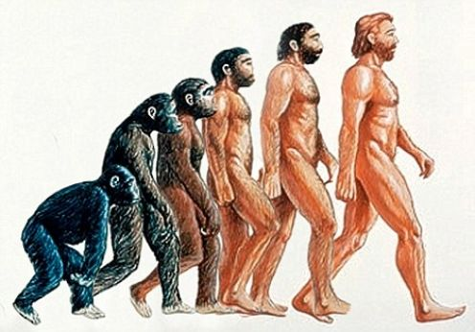
SOCIAL SCIENCE INQUIRY MODEL

Slide 2
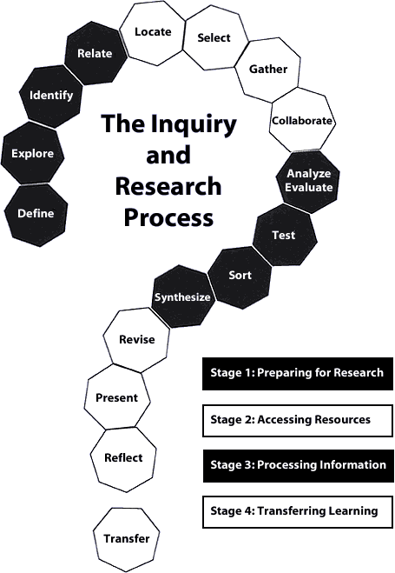
The social science inquiry model consists of 5
stages:
Identify a problem or research question
Develop a hypothesis
Gather data
Analyze data
Draw conclusions

Slide 3
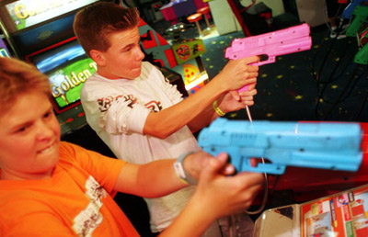
Identifying a Problem or Research Question
THE STARTING POINT FOR ALL INQUIRY IS A QUESTION OR A PROBLEM.
A QUESTION/PROBLEM PROVIDES A REASON FOR UNDERTAKING THE INQUIRY AND HELPS TO ESTABLISH A PLAN OF ACTION (How the inquiry will be conducted i.e. research method)
FOR EXAMPLE, A SOCIAL SCIENTIST MIGHT BE WONDERING ABOUT THE INFLUENCE OF VIOLENT VIDEO GAMES ON PEOPLE WHO PLAY THEM.
HE/SHE WOULD FORMULATE A QUESTION: IS THERE A LINK BETWEEN VIOLENT VIDEO GAMES AND YOUTH VIOLENCE?

Slide 4
DEVELOP A HYPOTHESIS
A HYPOTHESIS IS A POSSIBLE ANSWER TO A QUESTION AND A STARTING POINT FOR FURTHER INVESTIGATION.
A HYPOTHESIS INDICATES WHAT NEEDS TO BE TESTED AND WHICH RESEARCH METHOD TO USE.
THIS STEP IS CRUCIAL BECAUSE WITHOUT A GOOD HYPOTHESIS A RESEARCHER CAN WASTE A LOT OF TIME AND ENERGY COLLECTING INFORMATION THAT MIGHT NOT BE RELEVANT TO THE TOPIC.
A GOOD HYP. COULD BE: THERE IS A LINK BETWEEN VIOLENT VIDEO GAMES AND YOUTH VIOLENCE.

Slide 5
GATHERING DATA
THE INQUIRER MUST THEN DETERMINE HOW TO GATHER DATA OR INFORMATION.
THE METHOD USED SHOULD BE APPROPRIATE TO THE QUESTION AND HYPOTHESIS.
THERE ARE SEVERAL RESEARCH METHODS THAT A RESEARCHER MIGHT USE INCLUDING CASE STUDIES, SAMPLE SURVEYS, EXPERIMENTS, INTERVIEWS, OBSERVATIONS, ETC…
RESEARCH METHODS CAN BE COMBINED
i.e. surveys + interviews.

Slide 6
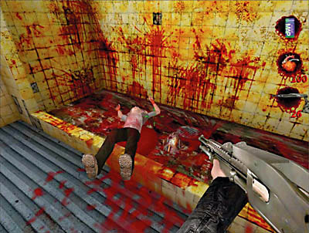
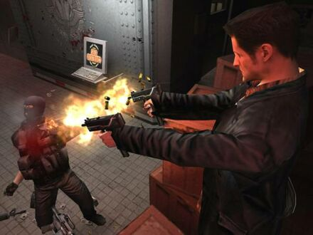
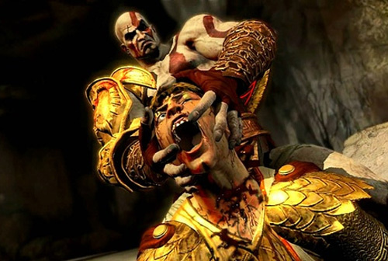

Slide 7
ANALYZING THE DATA
THE RESEARCHER MUST THEN ORGANIZE THE RAW DATA INTO MEANINGFUL FORMS i.e. Graphs, charts, tables…
DATA IS GENERALLY USELESS UNLESS IT IS ORGANIZED, INTERPRETED AND ANALYZED.

Slide 8
DRAWING CONCLUSIONS
AFTER THE DATA HAS BEEN ANALYZED THE INQUIRER DETERMINES WHETHER THE HYPOTHESIS IS EITHER SUPPORTED OR NOT.
THE RESEARCHER CAN ALSO SEE WHETHER THE HYPOTHESIS CAN BE ACCEPTED, REJECTED, OR REVISED.
PERHAPS THE RESEARCH SUGGESTS AN ALTERNATE CONLUSION i.e. THAT THERE IS A CORRELATION BETWEEN VIOLENT VIDEO GAMES AND YOUTH VIOLENCE BUT ONLY WITHIN MALES OR ONLY WITH YOUTH OF A CERTAIN AGE.

Slide 9
